Slide 1

Welcome to join Harbor Community Conference Call
06:00-07:00 AM (PDT) /
21:00-22:00 (Beijing Time)
2018/11/28 Wednesday
https://zoom.us/j/734959521
Twitter
Maillist
Slack (slack.cncf.io)
@project_harbor
harbor-users@googlegroups.com
#harbor
#harbor-dev
harbor-dev@googlegroups.com

Slide 2
Agenda
Harbor related(15 mins)
Demo: Introduction & Demo: Tencent Cloud Native Platform (TCNPlatform) (30 mins)
Any other topics from community (15 mins)

Slide 3
Development Progress
V1.7.0
Contributed by VMware Harbor
Online GC – Ready
Helm Chart repository enhancement - Ready
HA by Harbor Helm Chart - Ready
Contributed by CaiCloud （@Ca1989) - Ready
Retag (复制镜像)
Contributed by 360 Company (@kofj) - Ready
Image build history
V1.8.0 Planning
V1.6.2 Released
Clair cannot scan S3 storage because it does not have the CA certificate that signed the S3 storage url.
V1.7.0-rc1 Ongoing
RC1 will be ready in next week

Slide 4
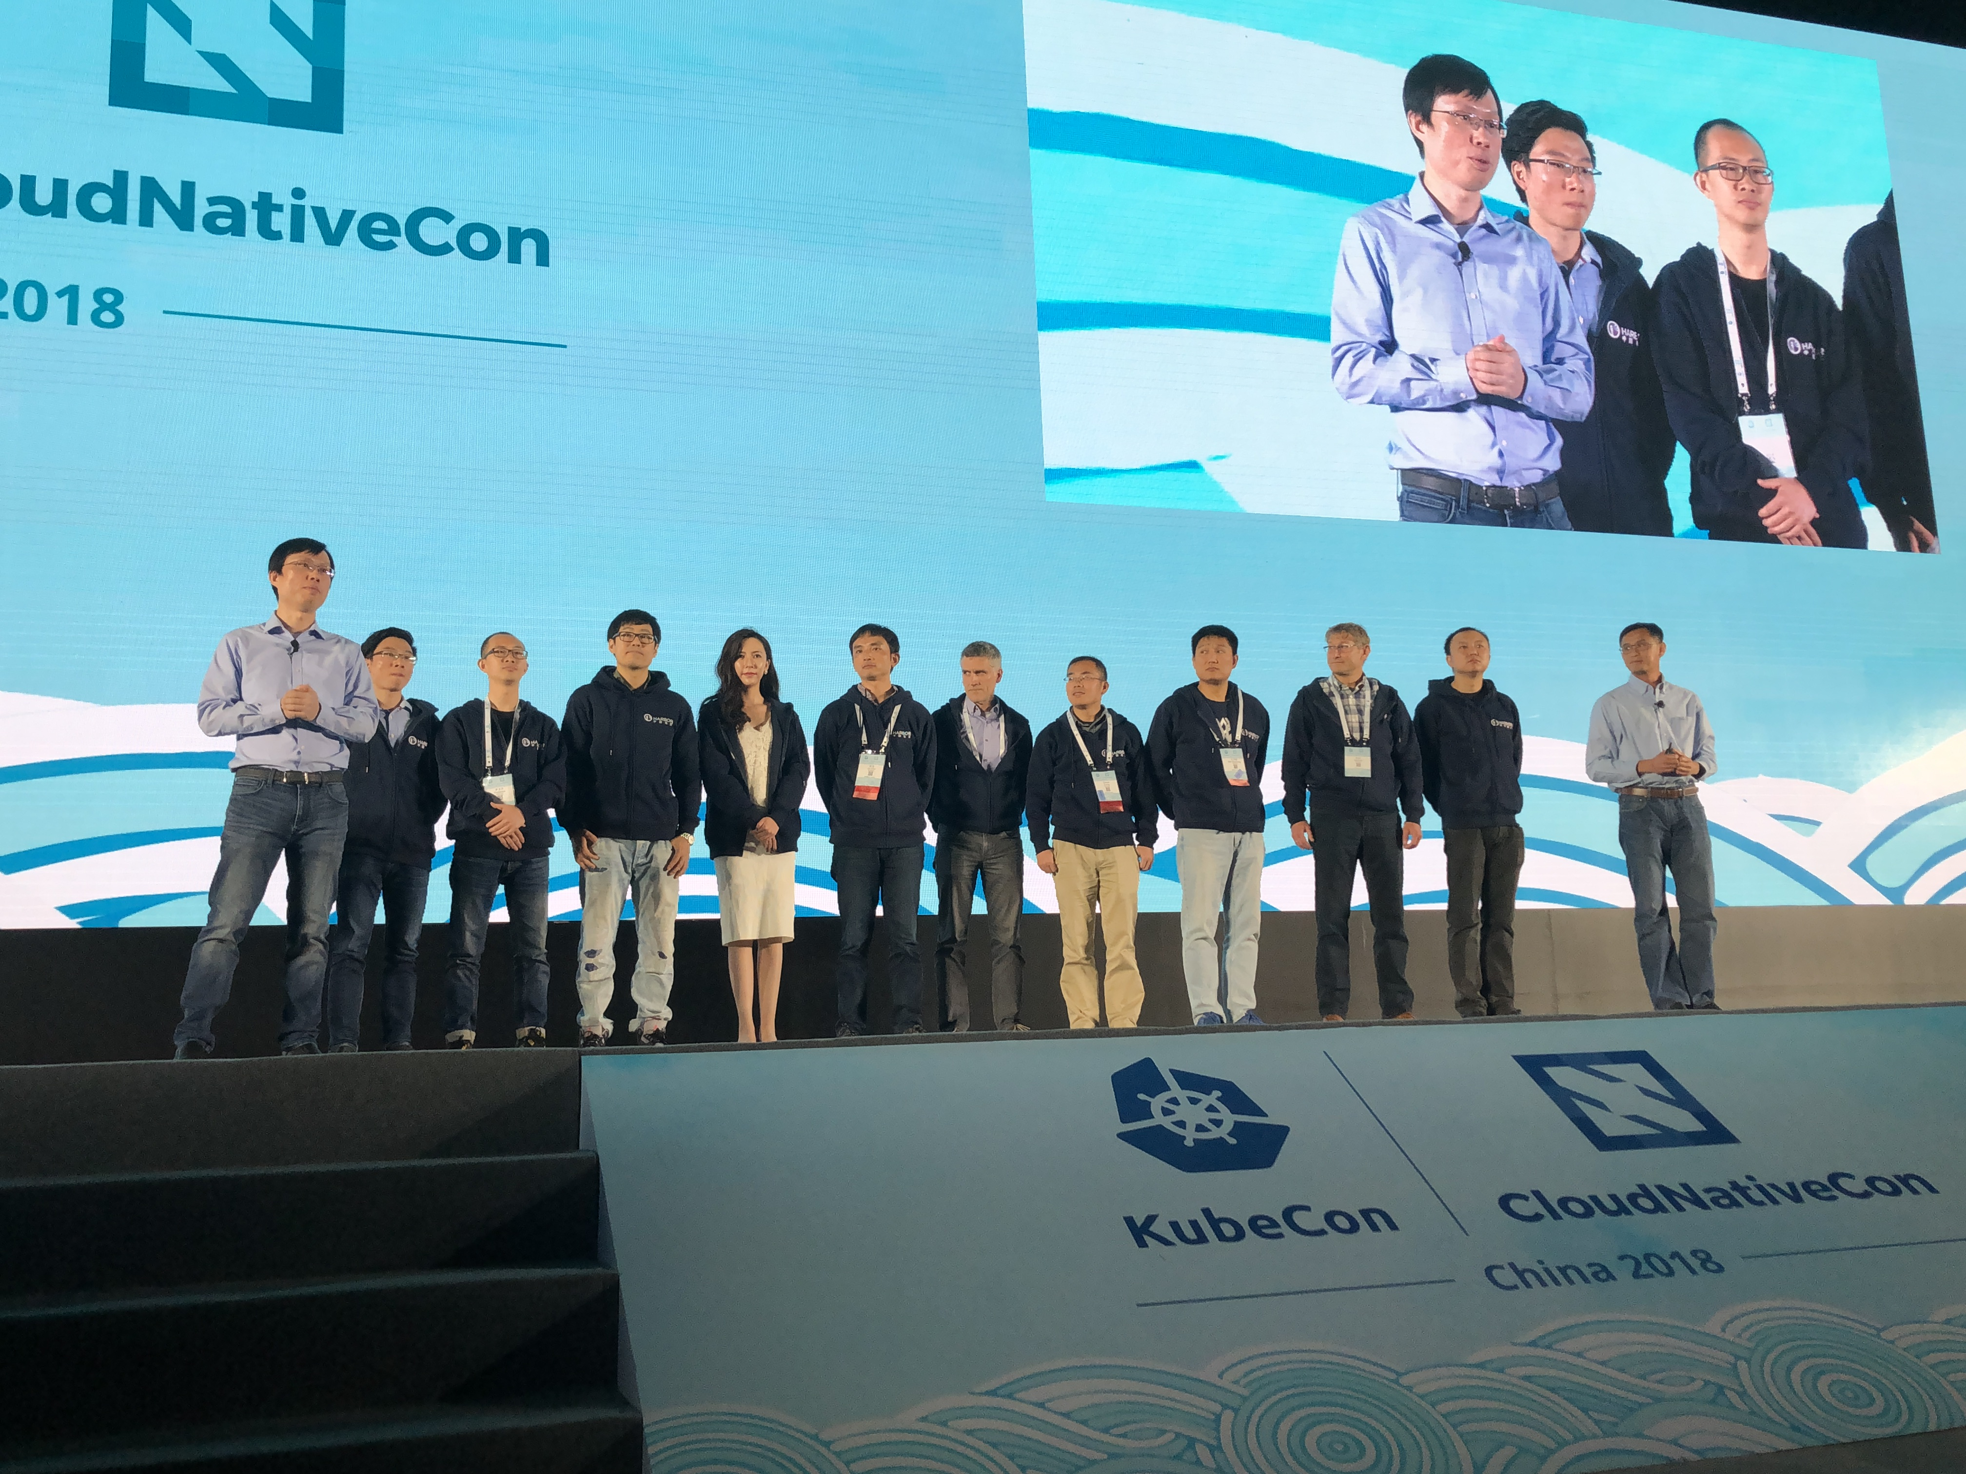
KubeCon Shanghai
Project Harbor graduates to Incubate project !!!

Slide 5
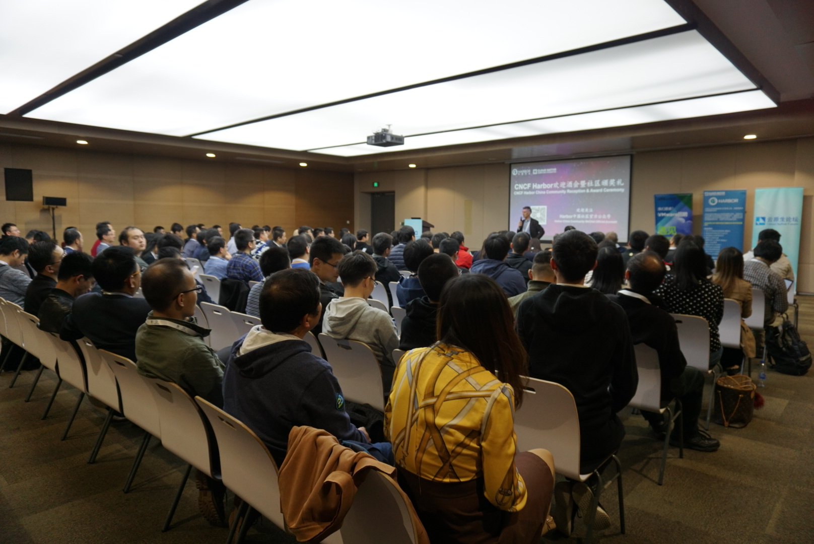
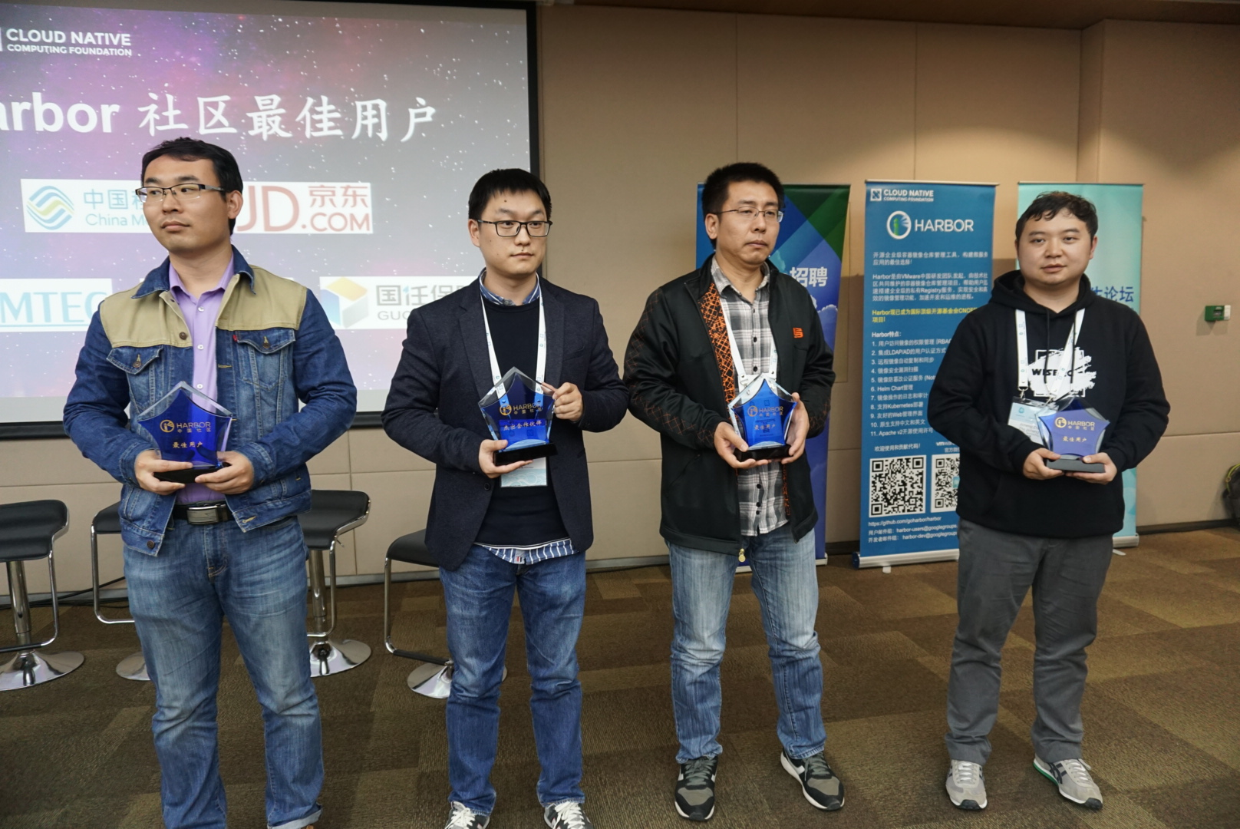
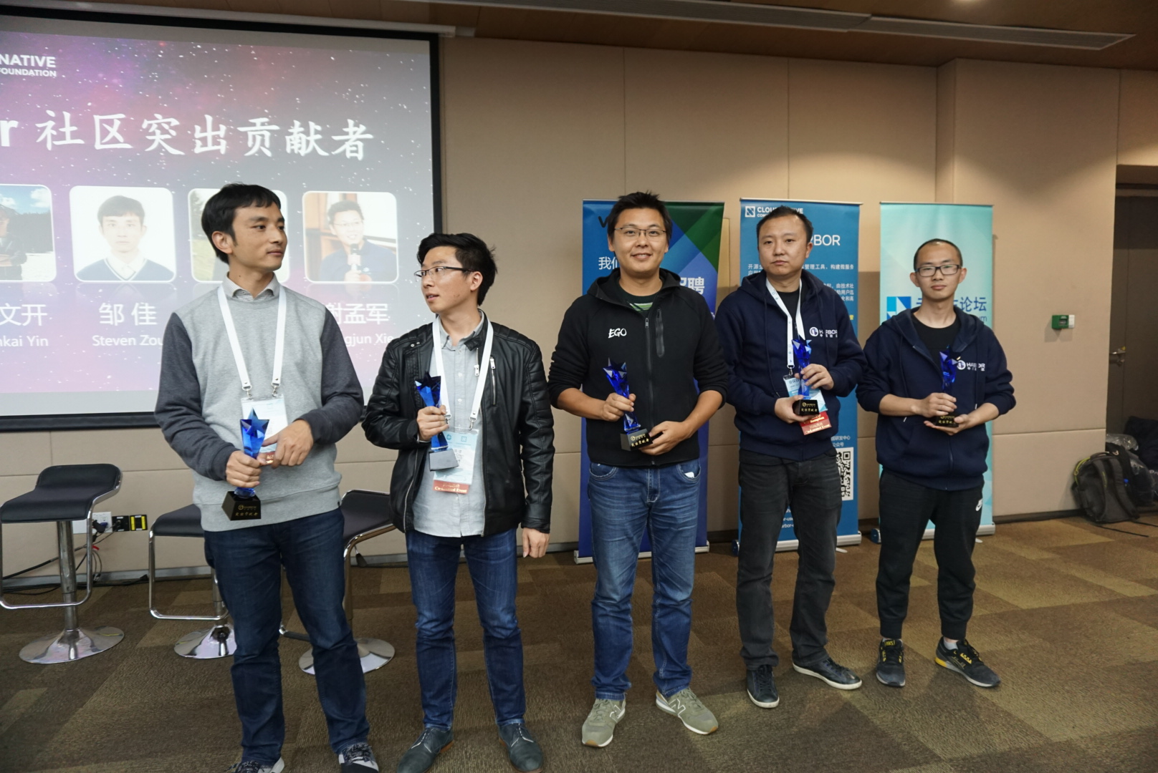
KubeCon Shanghai

Slide 6
KubeCon Seattle
Tuesday, December 11 • 11:40am - 12:15pm
Harbor Introduction - James Zabala & Henry Zhang
https://kccna18.sched.com/event/GrcE/intro-harbor-james-zabala-henry-zhang-vmware?iframe=no&w=100%&sidebar=yes&bg=no
Thursday, December 13 • 2:35pm - 3:10pm
Fly Your Containerized Environments by Joint Work of Harbor and Dragonfly - Jia Zou, VMware & Allen Sun, Alibaba
https://kccna18.sched.com/event/GrYh/fly-your-containerized-environments-by-joint-work-of-harbor-and-dragonfly-jia-zou-vmware-allen-sun-alibaba?iframe=no&w=100%&sidebar=yes&bg=no
Thursday, December 13 • 4:30pm - 5:05pm
Harbor deep dive – Tang Jiang, Jia Zou
https://kccna18.sched.com/event/Gre7/deep-dive-harbor-tan-jiang-jia-zou-vmware?iframe=no&w=100%&sidebar=yes&bg=no

Slide 7
DEMO: Tencent Cloud Native Platform
Tencent Cloud Native Platform (TCNPlatform) is a management platform to coordinate multiple k8s clusters. TCNPlatform provides auto-deploy application store which is based on Harbor. Tencent is willing to contribute is part of code to Harbor.
In this session, we will show a demo about the whole TCNPlatform including the applicaiton store. Further discussion about this function is wellcome.
Welcome Ryan!

Slide 8
Topics?
Any topics to discuss here?

Slide 9
Meeting minutes
Meeting is recorded and the recording link will be updated to the meeting schedule doc later: https://github.com/goharbor/community/blob/master/MEETING_SCHEDULE.md
The meeting slides will be uploaded to the community repo https://github.com/goharbor/community and put under the ‘conf-calls’ folder.

